Slide 1
‘Keeping it in the Family’ Tips for Engaging Family Businesses
By Lisë Stewart – Managing Director
The Center for Family Business Excellence

Slide 2
Why now?
24 Million…
The number of small businesses in the US today.

Slide 3
Business Transition is one of our greatest challenges…
45%...or more
The number of business that will transition ownership or leadership within the next 5 to 7 years…

Slide 4
What does this mean?
95% of businesses in the US today are family-owned or closely-held.
Over $10 Trillion in family business net worth that will be transferred in the next 15 to 20 years.
Almost 85 percent of business transitions fail due to a lack of communication, trust or next generation competency.

Slide 5
The Challenges
Life in the family business is a state of permanent whitewater…

Slide 6
Just when owners need to increase business value…
Gaining
or Draining?
Value
Third-Stage
Growth
Almost 35% sell or liquidate – often failing to realize their intended value.
Second-Stage
Wobbles
Start-Up
Time

Slide 7
They need us… so why don’t they use us?
“So whadamy supposed to do with this bidness? Eh?”

Slide 8
They do nothing… because
They don’t trust us…
They are ashamed…
They don’t believe they can afford us…
It is just too complex!

Slide 9
Tips for building trust and long-term relationships

Slide 10
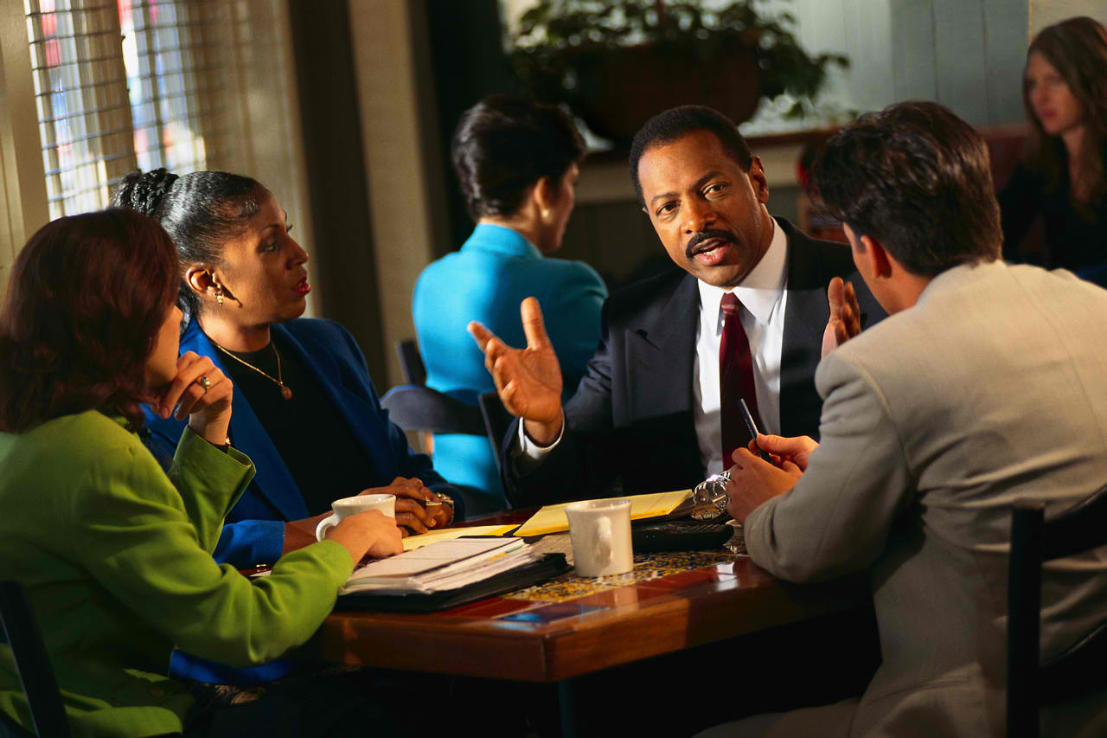
They want one trusted advisor…
A conductor of the orchestra, who, without judgement or desire to ‘sell’, will stand beside them on this difficult journey.

Slide 11
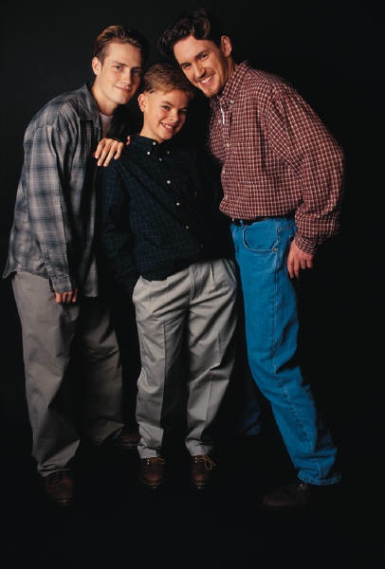
Honoring the Family - Protecting the Business
Successful transition planning will recognize the importance of maintaining the family, protecting life-long relationships, and enabling change with dignity.

Slide 12
Balance – the needs of the Business AND the Family.
Family Needs
Business Needs
Strategic Decisions

Slide 13
The Big Picture
Build Trust
Assess
Initial Plan
Build Value
Test Assumptions

Slide 14
Clarify your role
Doctor?
Facilitator, Coach, Advocate?
Expert?

Slide 15
Take a Baby Step Approach

Slide 16
Keep it Simple
Identify logical first steps (not necessarily low hanging fruit).
Break the step down into manageable bits – in terms of activity and cost.
Only agree to move to the next step after the “process review”.

Slide 17
Understand your client’s stage
Legacy Building Phase
Consolidation Phase
Entrepreneurial Phase
Gaining
or Draining?
Third-Stage
Growth
Value
Second-Stage
Wobbles
Start-Up
Time

Slide 18
Where are you? Where is your business?

Slide 19
Employ Positive Language

Slide 20
Old messages don’t work…
AVOID:
What keeps you up at night?
If you were to die tomorrow… what will happen to your family?
If you could no longer work, how will you support yourself?
What’s your worst nightmare in regard to this business, family, etc.?
TRY:
What makes you proud?
What was your greatest accomplishment?
What would you like to see survive in this company?
How would you like to describe your legacy?

Slide 21
Practice Verbal Aikido

Slide 22
Practice Reframing
You have options:
Hold it
Slam it back
Let it pass
Guide it and reframe it – reclaim your momentum!

Slide 23
Deal with emotional issues…
Before emotion becomes the issue!

Slide 24
Leaving a Legacy
Family businesses will endure or die depending upon how effectively they plan for the future. Those who survive will have managed to re-create the energy and wonder that fueled the original entrepreneurial spirit.

Slide 25
Questions

Slide 26
Contact Information
Lisë Stewart
Managing Director
Center Family Business Excellence
EisnerAmper LLP
eisneramper.com/familybiz
732.243.7790
lise.stewart@eisneramper.com

Slide 27
This publication is intended to provide general information to our clients and friends. It does not constitute accounting, tax, or legal advice; nor is it intended to convey a thorough treatment of the subject matter.

